Slide 1
The Battle of the Neighborhoods
A. Sethi
9th Dec 2019

Slide 2
In this project we are going to be analysing the city of Toronto and the neighborhoods within it. We are going to be analysing the Boroughs of Toronto and identifying the popular cuisines when it comes to the available food options within each of the Boroughs. The problem we are trying to solve here is to identify a potential location for a new restaurant and see which particular cuisines would provide a potential opportunity for success within those locations

Slide 3
Dataset
The data set we will be using for this project comprises of the following.
We will be picking up neighborhood information from Wikipedia - https://en.wikipedia.org/wiki/List_of_postal_codes_of_Canada:_M.
We will be importing location, local business, popularity and other related information from the Foursquare APi.
We will also be using a variety of python libraries.

Slide 4
Methodology
We will be targeting a singular borough of Scarborough for this particular study. We will create a DF for the neighbourhood information for Scarborough, add lat. And long. Details to the same. Followed by the same, we would import venue information using the FourSquare APi, group them by neighbourhood and sort the information using popularity metrics available via FS Api. We will further refine the information by classifying the businesses information in categories and then ordering them in order of popularity.
Our last step would be to cluster the businesses based on their geographic location into 3 specific clusters allowing us to develop further insight.
Step by step description of steps followed is provided in our report
Link: https://github.com/nktsthi/Coursera_Capstone/blob/master/The%20Battle%20of%20Neighbourhoods%20-%20A.%20Sethi.pdf

Slide 5
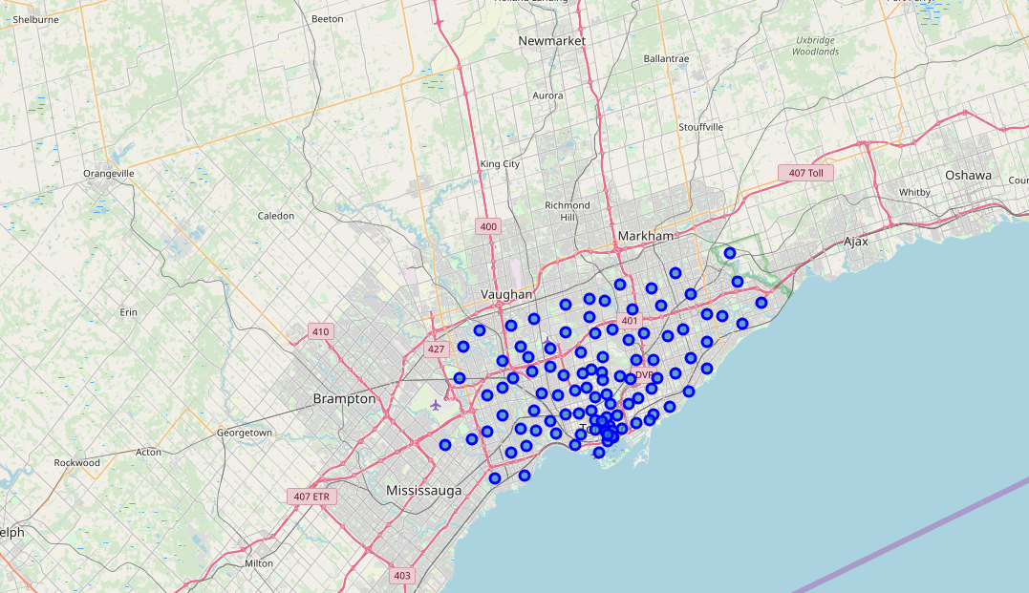
Map of Toronto with Markers

Slide 6
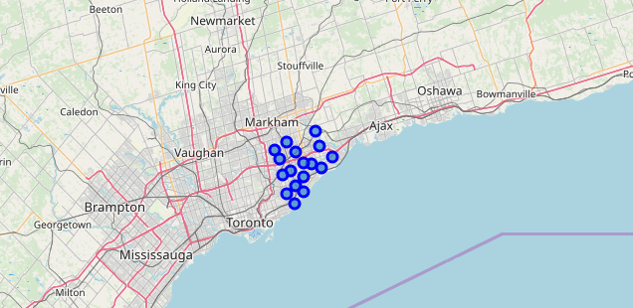
Map of Scarborough with markers

Slide 7
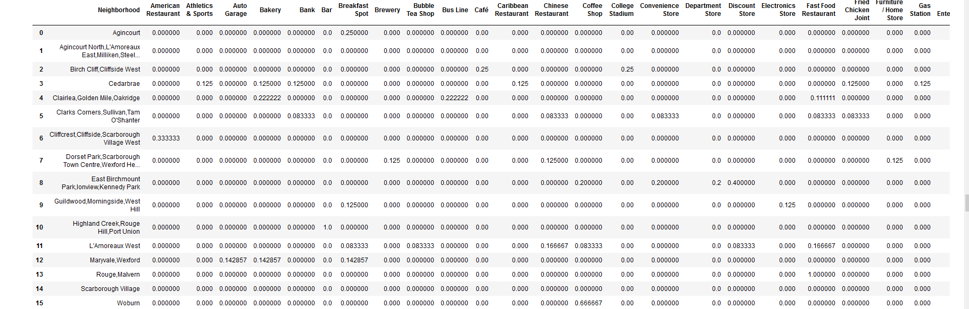
Neighbourhood Grouping of Venues

Slide 8
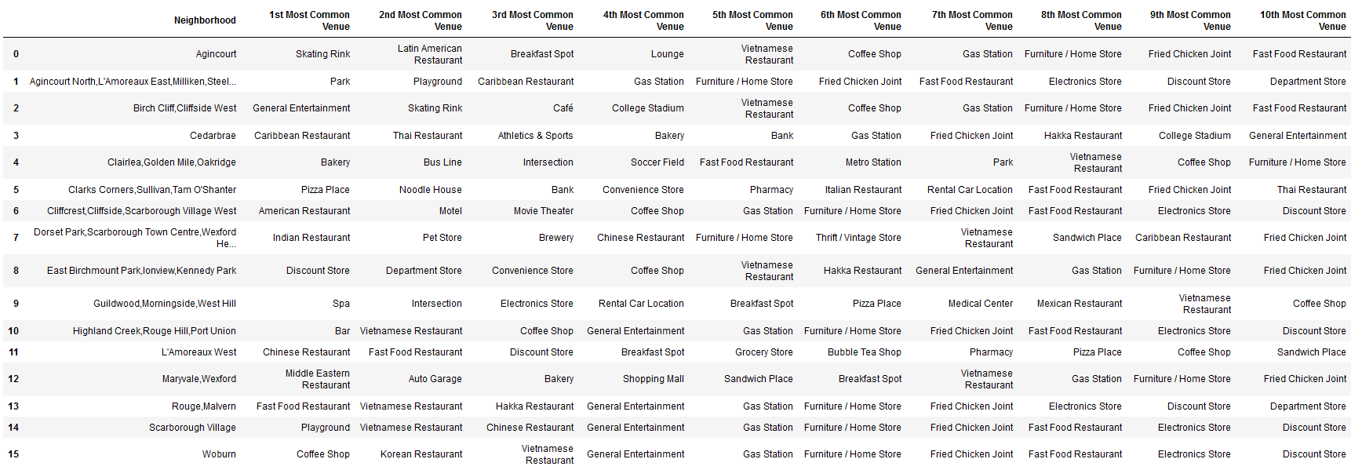
Neighbourhood venues sorted by popularity

Slide 9
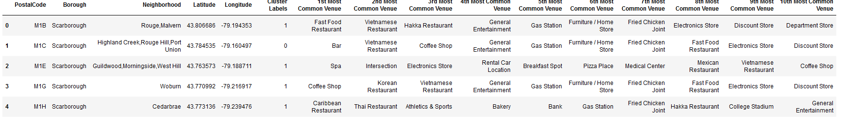
New DF with clustering information

Slide 10
Results
Based on the above information, we have identified the above conclusions
Cluster 2 in Scarborough is clearly the largest with the largest audience size and hence, opportunity.
There is not neccessarily a singular cuisine or theme that can be identified to have an extremely strong or dominating presence.
A fairly significant presence in top 10 popular venues for Chinese Restaurants, Indian Restaurants and Vietnamese Restaurants

Slide 11
Conclusions
Based on the above results, we simply do not have enough conclusive data to identify an extremely dominant market space when it comes to the food industry. There are clearly strong players with a somewhat larger presence i.e. Chinese, Indian and Vietnamese restaurants. This can be concluded to provide one of two paths of decision making. Either the market can be considered saturated with these opportunities or it can be considered to be a safe option to invest in considering the large demand.
Overall though, our study has been somewhat inconclusive from a business opportunity research point of view.

